Slide 1


OneKart
A single place for all your biddings

Slide 2

Team Members
Rhidwan Rashid 200042149
Sian Ashsad 200042151
Kazi Jawadul Islam Jishan 200042165

Slide 3
Table of Contents
Project Description
Features
Technologies
ERD

Slide 4
Description
OneKart can offer solution for a particular retailer, such as Meena Bazar, Shwapno to manage its inventory, customers, employees and branches.
The motive is to facilitate the management work in retailers, so that most of them can be carried out digitally.
OneKart can help to improve and ease interactions among customers, vendors and retailer staff.

Slide 5
Features
As a customer, browse existing products of different branches
Database keeps history of a list of orders
Customers can search for existing and available products
Cart and checkout system for customers
Branch managers can process and confirm orders
Branch managers can upload and manage products

Slide 6







Technologies
Frontend: ReactJS + CSS
Backend: NodeJS + Express
Database: MySQL
Version Control : GitHub

Slide 7
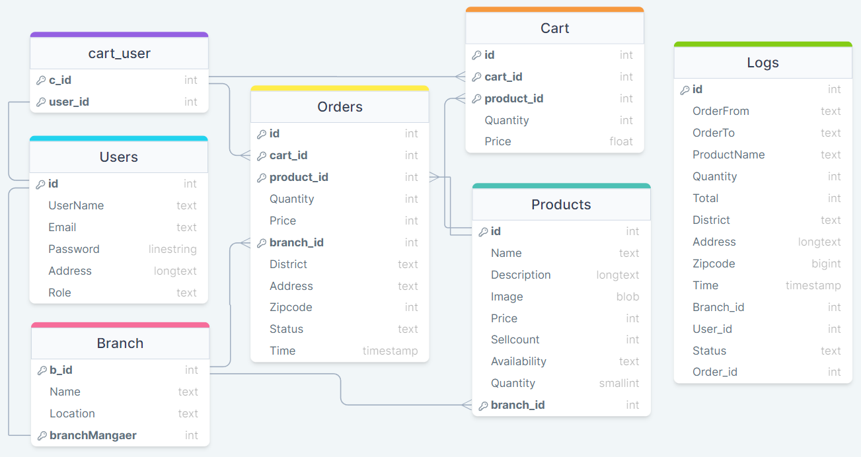
Entity Relationship Diagram

Slide 8
Project Demonstration

